Slide 1

HOSPITAL PORTAL SYSTEM
A Group Project By:
-Vedant Misra(B091)
-Prince Tibadia(B079)
-Priyam Shah(B076)
-Roshan Jain(B077)

Slide 2

INTRODUCTION
A hospital portal system is a system which helps medical institutions to maintain records of patients, doctors and even general staff to cut down the margin of error. Certain features of a hospital portal system include:
Maintain the medical records of the patient
Maintain the contact details of the patient
Maintain the details of the doctors
Keep track of the appointment dates
HOSPITAL PORTAL SYSTEM
“ Whenever the art of medicine is loved, there is also a love of humanity. ”

Slide 3
ADVANTAGES OF HPS
COST EFFECTIVE
EASE OF ACCESS
TIME SAVING TECH
DATA SECURITY
HOSPITAL PORTAL SYSTEM
Reduces time-spent and improves efficiency
Data security and correct data retrieval made possible
Cost effective and easily manageable
Easy access to patient data with correct patient history

Slide 4
FEATURES OF THIS PROJECT
Current project extends to the following features:
01
Add patients to the hospital database
Helping doctors to search for a specific patient in order to view their medical history from the database.
02
HOSPITAL PORTAL SYSTEM
Helping doctors to manage their schedules by using a TODO list which maintains a record of upcoming appointments and surgeries.
03
04
Allows selected admins to add a new doctor or staff member to the existing workforce of the hospital.

Slide 5


USERS OF THIS PROJECT
HOSPITAL PORTAL SYSTEM
Doctors
Users
Doctors who might not have thorough knowledge of DML commands used to access and manipulate the databases of patients.
Patients who need to schedule appointments with doctors and can submit their symptoms and get the doctor’s diagnosis on that basis

Slide 6
SCOPE OF THIS PROJECT
Backend
This project helps us to understand the basics of database management and handling
Integration
It uses a web based API which acts as a link between database and a naïve user. It also demonstrates the applications of python’s huge library of tools and modules.
HOSPITAL PORTAL SYSTEM
GUI/UI
Helps us understand how a GUI/UI helps a naïve user to navigate through a system and use it according to his needs without any hassle.

Slide 7






TECHINCAL SPECIFICATIONS
Title here
HOSPITAL PORTAL SYSTEM
The current API is based on Python, CSS, SQLite and SQLAlchemy. Python was used because of its vast libraries and applications. One of the modules used for this system is Flask. SQLAlchemy and SQLite were also used in order to maintain and manipulate databases. CSS being an integral part of modern web development, is a highly effective tool for HTML which provides a good control over layout and presentation of the website.

Slide 8
TECHINCAL SPECIFICATIONS
WHY SQLite and SQLAlchemy
Title here
HOSPITAL PORTAL SYSTEM
SQLite database requires no administration, it works well in devices that must operate without expert human support.
SQLite works great as the database engine for most low to medium traffic websites.
People who understand SQL can employ the sqlite3 command-line shell to analyze large datasets.
SQLAlchemy is a library that facilitates the communication between Python programs and databases. Most of the times, this library is used as an Object Relational Mapper (ORM) tool that translates Python classes to tables on relational databases and automatically converts function calls to SQL statements.

Slide 9
TECHINCAL SPECIFICATIONS
WHY Flask
Title here
Flask gives the developer varieties of choice when developing web applications, it provides you with tools, libraries, and mechanics that allow you to build a web application.
Since it’s a microframework it does not depend on any external libraries.
Flask is also ORM friendly means a developer can connect his/her favourite ORM in this case SQLAlchemy.
It is easy to deploy.
It has a minimalist approach which means the user decides how they want to build the application
HOSPITAL PORTAL SYSTEM

Slide 10
CONCLUSION
The hospital management system is the inevitable part of the lifecycle of the modern medical institution.
It automates numerous daily operations and enables smooth interactions of the users. Developing the hospital system software is a great opportunity to create the distinct, efficient and fast delivering healthcare model. Implementation of hospital management system project helps to store all the kinds of records, provide coordination and user communication.
HOSPITAL PORTAL SYSTEM
This beneficial decision covers the needs of the patients, staff and hospital authorities and simplifies their interactions.

Slide 11
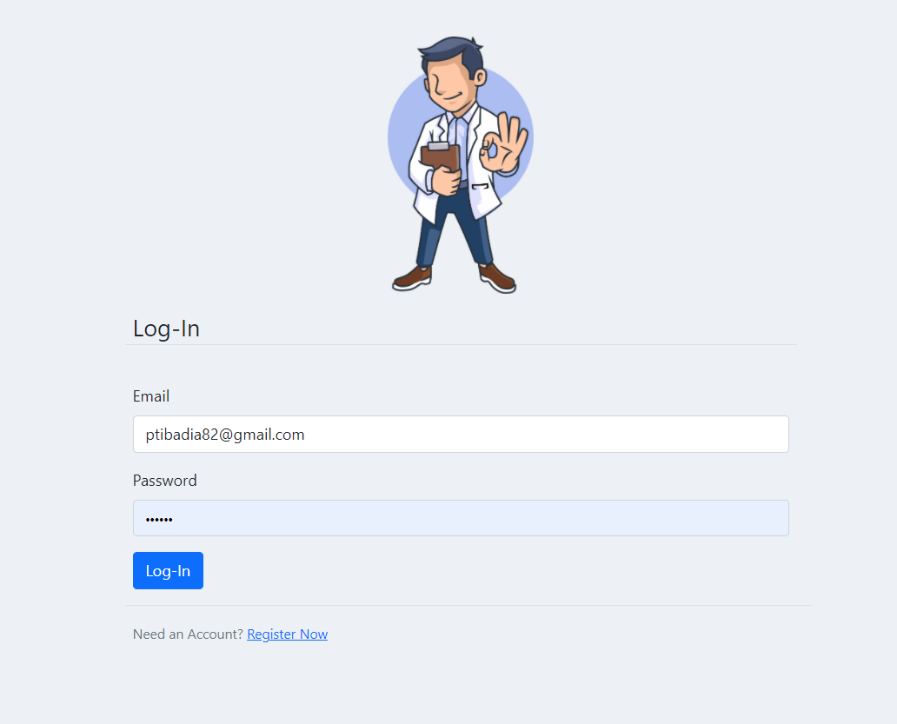
Initial Login Page
This page allows an existing user to login to the page.
In case if the user does not have an account, the page has a link to redirect him/her to the register page
HOSPITAL PORTAL SYSTEM

Slide 12
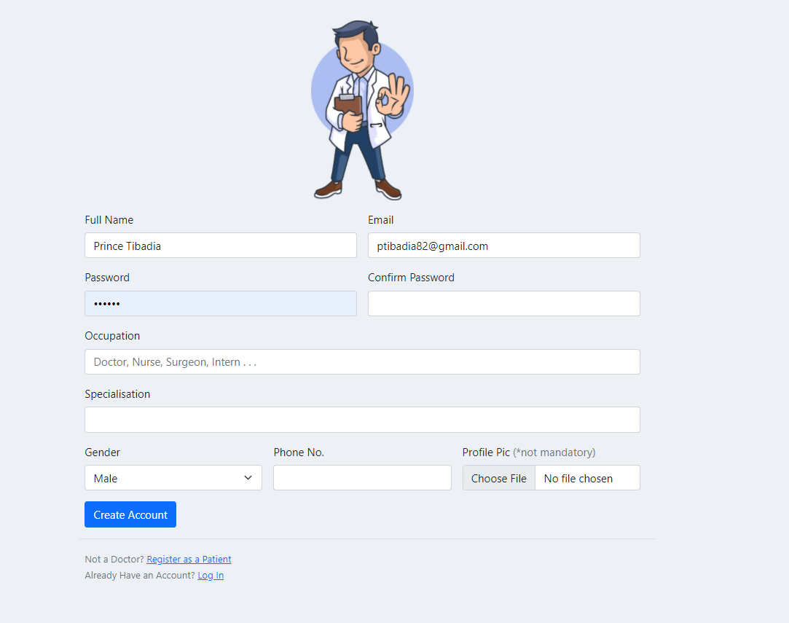
‘Register as a Staff Member’ Page
This page allows the user to register as a doctor.
In case if the user happens to be a patient there is a separate redirect link for the patient registration
HOSPITAL PORTAL SYSTEM

Slide 13
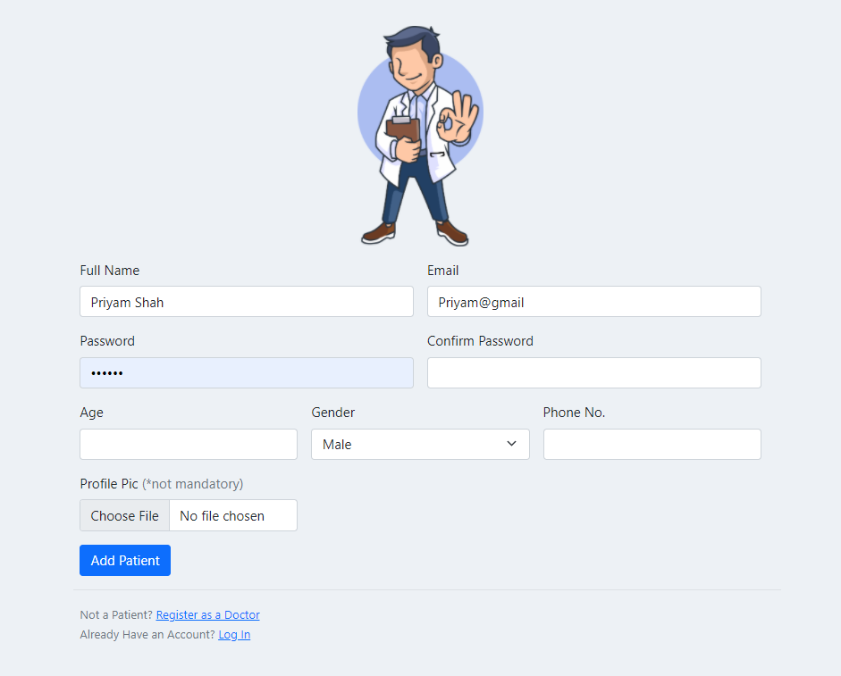
‘Register as a Patient’ Page
This page allows the user to register as a doctor.
In case if the user happens to be a patient there is a separate redirect link for the patient registration
HOSPITAL PORTAL SYSTEM

Slide 14
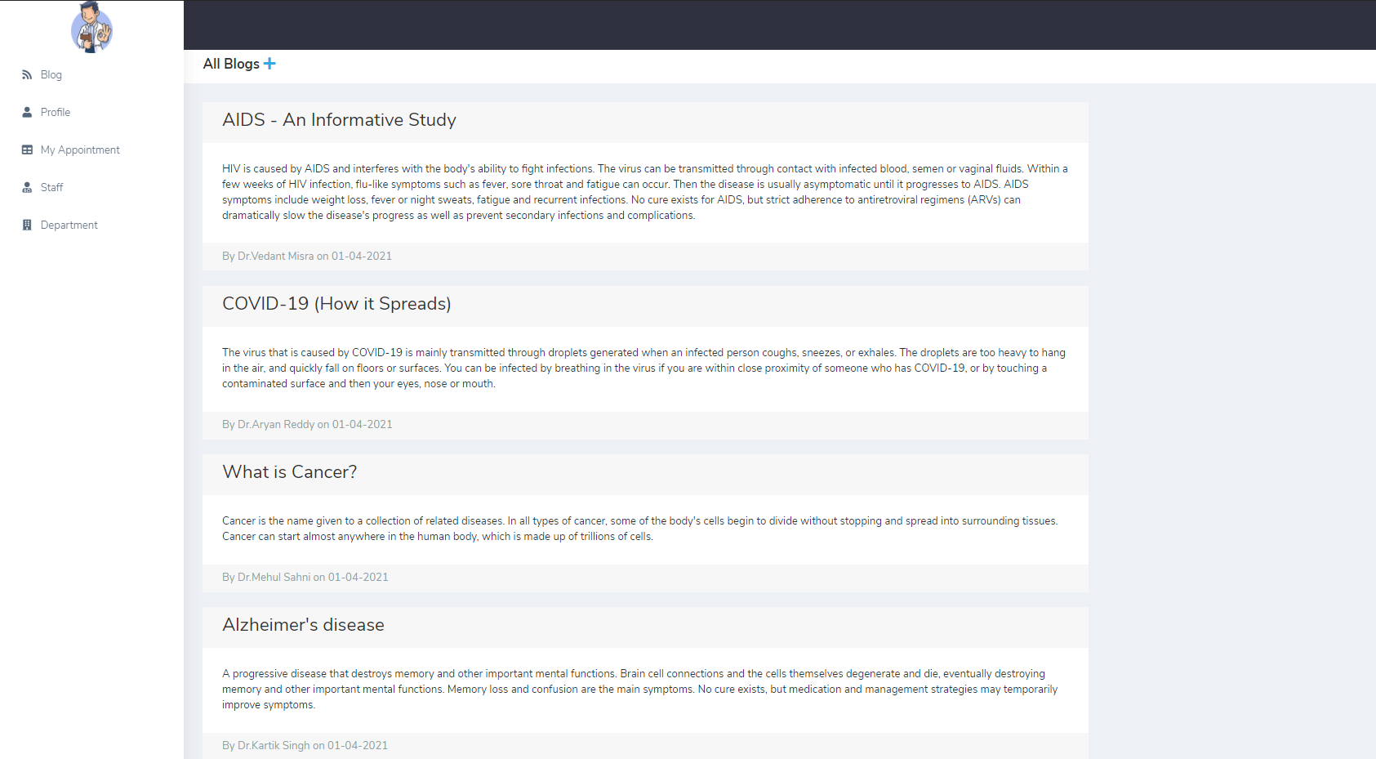
Blog page
Every user lands on a blog page which is made by doctors i.e. only doctors can post blogs on it.
HOSPITAL PORTAL SYSTEM

Slide 15
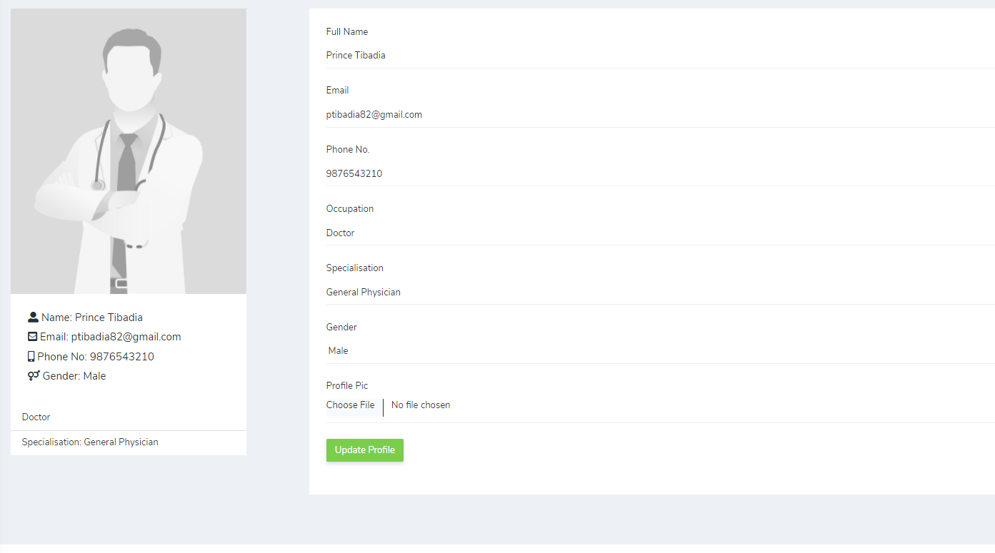
Profile page
This page consists of the profile of the account logged in with
The user can even update his/her profile over here
HOSPITAL PORTAL SYSTEM

Slide 16
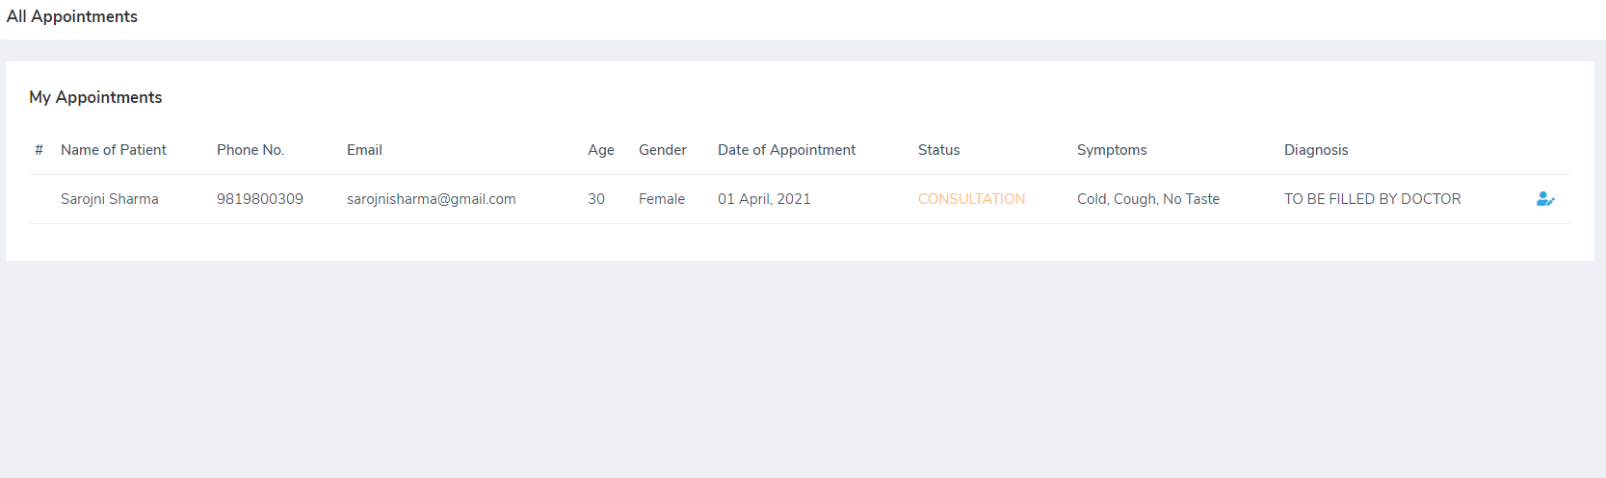
Appointment Page (Doctors Login)
This page shows the appointments a doctor has ever had till date.
HOSPITAL PORTAL SYSTEM

Slide 17
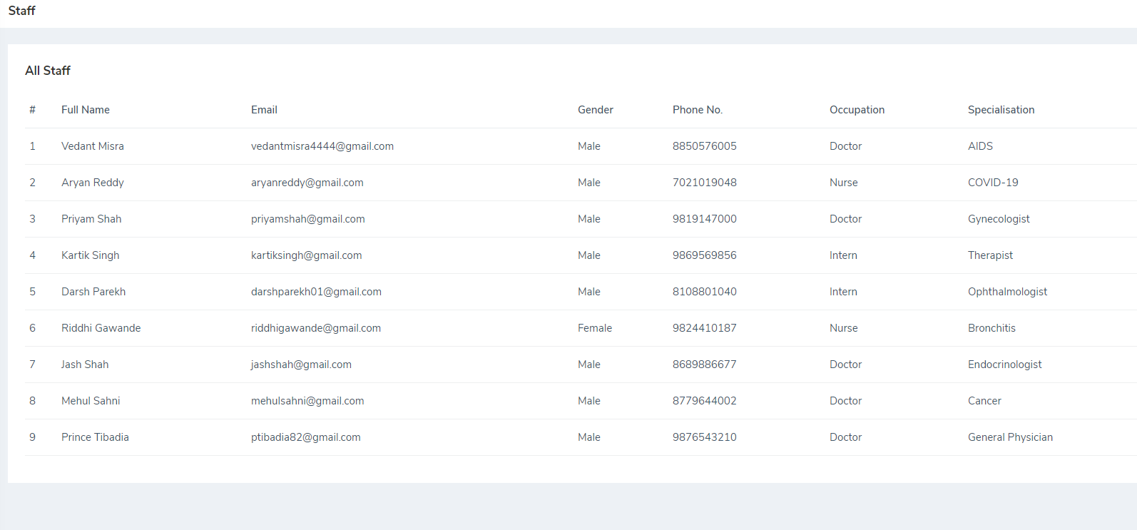
Staff Page
This page displays the list of all staff members in the institution
A patient may refer to this page in order to book an appointment according to his/her symptoms.
HOSPITAL PORTAL SYSTEM

Slide 18
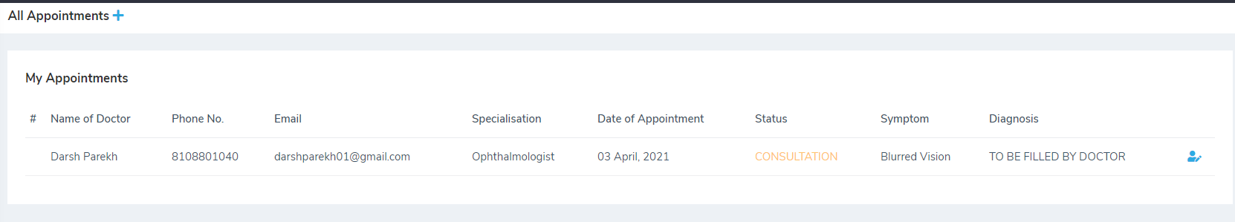
Appointment Page (Patients Side)
This page displays the upcoming or all finished appointments of the patient
The user can also book another appointment with a doctor on this page
HOSPITAL PORTAL SYSTEM

Slide 19
THANKYOU
HOSPITAL PORTAL SYSTEM

